Slide 1
USDA
Natural Resources Conservation Service (NRCS) Environmental Quality Improvement Program (EQIP)
Edwards Aquifer State Resource Concern (EA SRC)
EA SRC Program Summary
Jim Boenig, P.E.
Director of Aquifer Protection, EAA
Notes:
The NRCS appreciates the years of previous partnership with the EAA which includes Brush Management and installation of more efficient irrigation systems. By the EAA being a sponsor, the EA SRC will bring additional NRCS EQIP funding to the region for conservation practices that benefit both the ag producer and our environmental goals.
<number>

Slide 2
Discussion Topics
EQIP SRC Program Overview
Other SRCs in Texas
Proposed NRCS Practices
EAA Responsibilities as an SRC Sponsor
Annual Tasks and Schedule
Notes:
This presentation provides a quick tour of the EQIP SRC Program benefits, the focus of EAA Practice priorities, and EAA responsibilities as Program Sponsor, and the annual schedule of events.
<number>

Slide 3
USDA NRCS EQIP EA SRC Program Overview
  Non-Regulatory: Voluntary conservation program for agricultural producers.
  Benefits Ag Productivity and Environment: Practices benefit working agricultural land.
  Additional NRCS Funding: EA SRC EQIP funding is in addition to County-based NRCS EQIP funding. ($3M-$6M in 5 yrs., estimated.) EAA funding is separate from EQIP funding to provide incentives.
  Focus on Local Environmental Priorities: Program Sponsor (EAA) assists NRCS to select beneficial practices and develop ranking criteria to evaluate applications for approval.
  Results Oriented: Approved applicants must commence Practice within 1 year of contract award. Payment incentive paid by NRCS (typically 30 to 50%) only after Practice is installed and certified to meet NRCS standards.
  Measurable Benefits: Each SRC Program is designed to achieve measureable watershed results within 5 years and terminate. If successful, a new SRC with new goals can be applied for in future years.
Notes:
We must make the producers aware of the Program and make it attractive.
Program is based on mutual benefits to producers and the EAA
The NRCS budget is 80% County based and 20% SRC based. The SRC effectively adds NRCS funding to our region, ($1M to $2M per year for 5 years anticipated).
EAA will have influence on which Practices are prioritized in which areas.
Not long term multi year projects. NRCS provides all technical assistance.
We need significant enrollment to meet Program goals.
A successful Program which creates measurable results not only benefits our goals but meets NRCS goals. Measureable results will grow the Program, increase our visibility, and increase our chances for additional NRCS funding in future years.
<number>

Slide 4
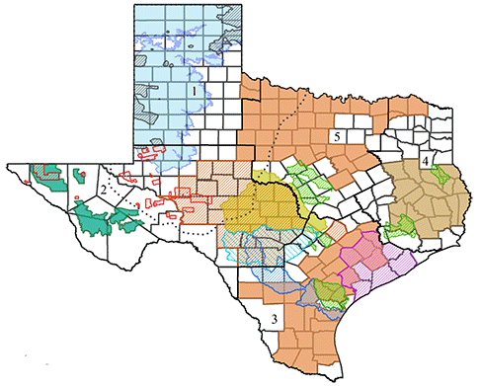
Priorities of Other SRCs in Texas
  12 SRCs were established in Texas during FY 2015.
  4 SRCs were added in FY 2016 including the EA SRC
  Statewide SRCs include:
    Poultry, Dairy, Beef Confined Animal Feeding Operations (CAFO)
      Concerns: Soil Quality and Erosion, Water Quality and Quantity, Plant Health,
      Air Quality, Animal Health.
  SRCs in portions of our Region include:
    Nueces River Basin – (Sponsor NRA)
      Concerns: Watershed Water Quality and Water Quantity
      2015: 33 contracts for $511K, only 1 in our area for $9,708.
  SRCs with similar goals include:
    Highland Lakes (Sponsor – LCRA)
      Concerns: Water Quality, Water Quantity, Soil Erosion, Soil Health
    Central Gulf Coast Irrigation (Sponsor – Rice Council)
      Concerns: Water Quality, Water Quantity, Soil Erosion, Soil Health, Wildlife Habitat
      Primary Strategy: Installation of Water Conserving Practices
Notes:
The NRCS discontinued previous programs and started a clean slate of SRCs in 2015. As of 2016, there are now 16 SRCs across the state. Some have goals similar to the EA SRC.
<number>

Slide 5
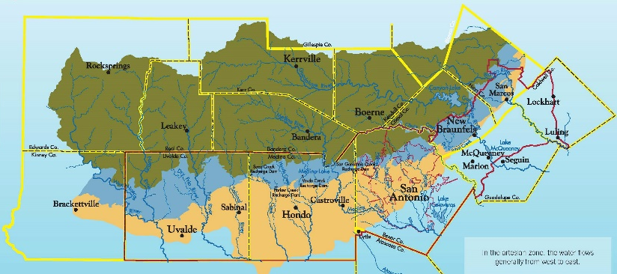
Goals of the EA SRC Program
  Enhance Local/Regional agriculture productivity and environmental objectives.
    Location Focus Areas
    Recharge & Contributing Zones: Improve Soil Health, Reduce Erosion
    Artesian Zone: Efficient Irrigation, Reduce potential pollution
  EAA Resource Objectives:
    Water Quality - Reduce erosion (land and stream), decommission substandard wells.
    Water Quantity – Efficient use of water, lower water demand by improving soil health.
    Climate Change – Reduce energy consumption, absorb carbon, reduce emissions.
Notes:
The NRCS EQIP application ranking criteria for the EA SRC will prioritize the certain practices in specific locations within the Edwards Aquifer system.
Generally, the EA SRC is prioritizing the goals and objectives listed above.
<number>

Slide 6
Resource Concerns and Recommended Practices
l
Primary Focus
Includes EAA Partial Reimbursement within Jurisdictional Boundary
Water Quality Degradation (Excessive Sediment) in Contributing and Recharge Zones – Rangeland and Riparian Areas
  (550) Range Planting, (390) Riparian Herbaceous Cover,
  (391) Riparian Forest Cover, (528) Prescribed Grazing,
  (314) Brush Management (Mechanical).
Water Quantity (Inefficient Use) in Artesian Zone
  (441) Micro-Irrigation System, (442) Sprinkler Irrigation System,
  (449) Irrigation Water Well Management.
  Water Quality Degradation (Pollutants) within Edwards Aquifer System
    (351) Well Decommissioning (Edwards) (319) On-Farm Secondary Containment
Notes:
The EAA prioritized this list from over 200 Practices on those we feel will be the most mutually beneficial to Producers and the EAA.
Some practices overlap several goals which is a bonus.
As noted above, the practices listed on this slide are eligible for EAA reimbursement, in addition to NRCS funding, if the practice is in the selected “zone” of the EA system and within the EAA jurisdictional boundary.
<number>

Slide 7
Resource Concerns and Recommended Practices
l
Secondary Focus
Water Quality Degradation (Excessive Sediment) in Edwards System to benefit cropland - Non-Structural
  (512) Forage & Biomass Planting, (386) Field Border,
  (393) Filter Strip, (412) Grassed Waterway,
  Residue & Tillage Management – (329) No Till or (345) Mulch Till.
Water Quality Degradation (Excessive Sediment) in Contributing and Recharge Zone - Structural
    (580) Streambank Protection, (600) Terrace,
    (638) Water & Sediment Control Basin.
Notes:
While all 22 listed practices are considered beneficial to the Aquifer system, the practices listed above are in the Secondary Focus zone. While these practices are eligible for NRCS EQIP funding, there is no EAA funding available for these practices in 2016..
<number>

Slide 8
EAA Responsibilities as an SRC Sponsor
  Develop the EA SRC Proposal:
  Select SRC practices and the boundary for each practice.
  Provide community outreach and gather feedback for mutual benefit of Ag producers and the EAA.
  Provide EAA funding to provide incentives for the prioritized practices. (EAA funding is not a SRC requirement.
  Develop methods to measure expected environmental improvements from each Practice.
Notes:
The EA SRC proposal was developed in October 2015 and was approved in February 2016.
<number>

Slide 9
EAA Responsibilities as an SRC Sponsor
Annual tasks after the EA SRC is approved:
Develop the scoring/ranking criteria of Practices with NRCS Staff.
Conduct outreach meetings and create brochure to notify Ag Producers of Program details.
Field inspect in order to administer payment of EAA incentives, if applicable.
Track measures which quantify benefits of Practice implementation.
Document Program successes with field visits and interviews.
Provide annual reports of Program project implementation and beneficial impacts.
Review Program effectiveness and Practice scoring/ranking criteria on an annual basis.
Notes:
The EA SRC can be modified each year and is expected to continue for 5 years before expiring. The major EAA annual tasks are listed above.
<number>

Slide 10
Local Partners/ Community Outreach
Develop partnerships with Agricultural organizations
  Farm Bureau
  Soil & Water Conservation Districts
  Local Groundwater Districts and River Authorities
Provide community outreach and educational meeting(s).
  Inform Ag Producers within the EA SRC focusing on Uvalde, Medina, Bexar, Comal, and Hays Counties.
  Obtain feedback from the Ag community for program improvements which can be made on an annual basis.
  Provide case studies of property and watershed improvement impacts for selected Owners willing to participate.
Notes:
Meeting with and obtaining feedback from agricultural organizations is critical to our proposal and success of the Program.
The EAA desires the EA SRC to be mutually beneficial to the ag producer and to EAA goals to protect, manage, and enhance the Edwards Aquifer system.
<number>

Slide 11
Annual Program Schedule (Approximate)
NRCS Notification of annual EA SRC EQIP Funding Nov - Feb
NRCS EQIP Evaluation of Applicants Multiple, TBD
NRCS initiates EQIP Contracts Multiple, TBD
Outreach and Monitor the EA SRC Program Apr - Dec
Develop EAA program budget for following year Jun - Sep
Review EA SRC Goals, Practices, and Ranking Criteria Oct - Dec
EAA Partial Reimbursement for Completed Practices Nov - Dec
Notes:
Applications are accepted continuously but awards are made periodically during the year. 50% of federal funding is typically received in November with the remainder available by Mar-Apr. For 2016, the November funding was delayed until March. The State budget for SRCs last year was approximately 20% of the State’s $60M NRCS EQIP budget (12M).
<number>

